Slide 1
Preparing and Evaluating 21st Century Faculty
Aligning Expectations, Competencies and Rewards
The NACU Teagle Grant
Nancy Hensel, NACU
Rick Gillman, Valparaiso University
Terry Weiner, The Sage Colleges
Lily McNair, Wagner College

Slide 2
Changing Faculty Work I
Link their teaching to global education and issues.
Connect their classes and students to the community through service learning.
Prepare students to work in diverse, multicultural settings where collaboration is essential.
Provide evidence that students are successful at achieving course- and university-level learning outcomes.
Know and demonstrate effective use of best practices in teaching, inside and outside the classroom.
Be familiar with interdisciplinary connections relevant to their subjects and “translate” them into relevant student learning.
Integrate rapidly changing technology and media into their courses.
Mentor students well beyond advising on course work.
Participate in increasingly interdisciplinary projects and teams.

Slide 3
Changing Faculty Work Cont’d
Collaborate with international partners on global problems and issues.
Seek and obtain external sources of funding to support their work.
Respond to increased expectations of scholarly productivity and quality.
Volunteer more time and talent to professional organizations—often to multiple organizations.
Direct undergraduate research.
Help raise retention and graduation rates.
Contribute to controlling the cost of attending college.
Recruit new students.
Respond to increased reporting requirements by governmental agencies.
Serve as active members of a larger set of campus and community committees.

Slide 4
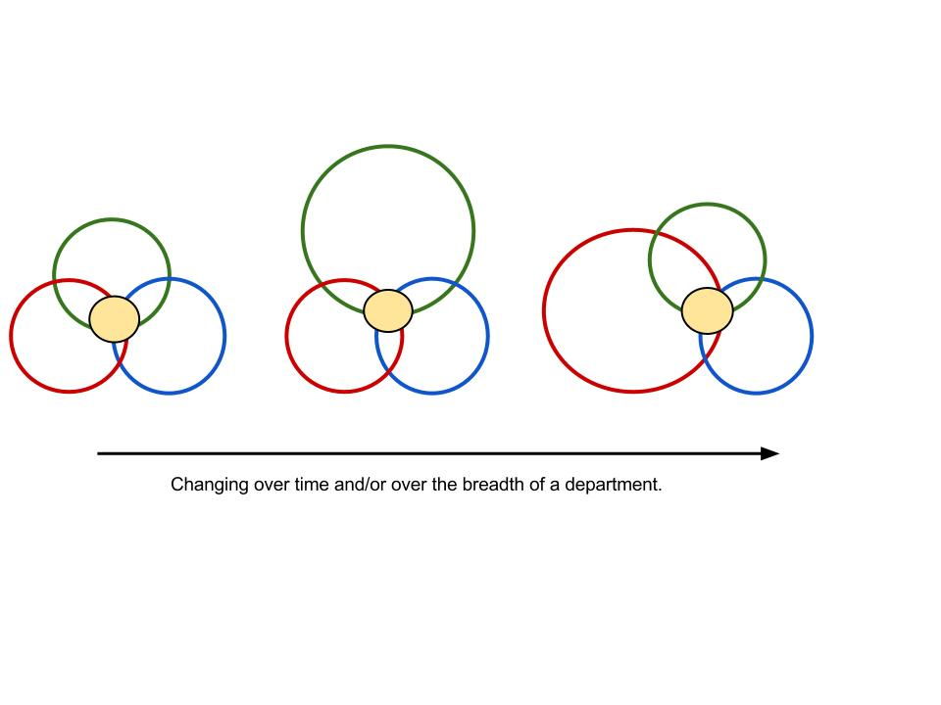
Changing models of faculty work over time and/or over the breadth of a department

Slide 5
The Faculty Evaluation Problem
A cookie-cutter approach to faculty evaluation based on the “holy trinity” of teaching, scholarship, and service
Faculty at times act as “independent contractors,” though this is less common at NACU schools
Does not respond to the changes, shifts, and emphases over the lifecycle of a faculty member
Does not respond to the changing goals and needs of academic departments
Fails to align the faculty and department goals with student learning focused mission of NACU institutions
Limits recruit to the needs of the curriculum (like areas of specialty)

Slide 6
The Faculty Workload Problem
Asking all faculty to excel in all areas.
Undercounting the effort involved in non-credit load bearing work.
Simply reducing TLC is an unsustainable model.

Slide 7
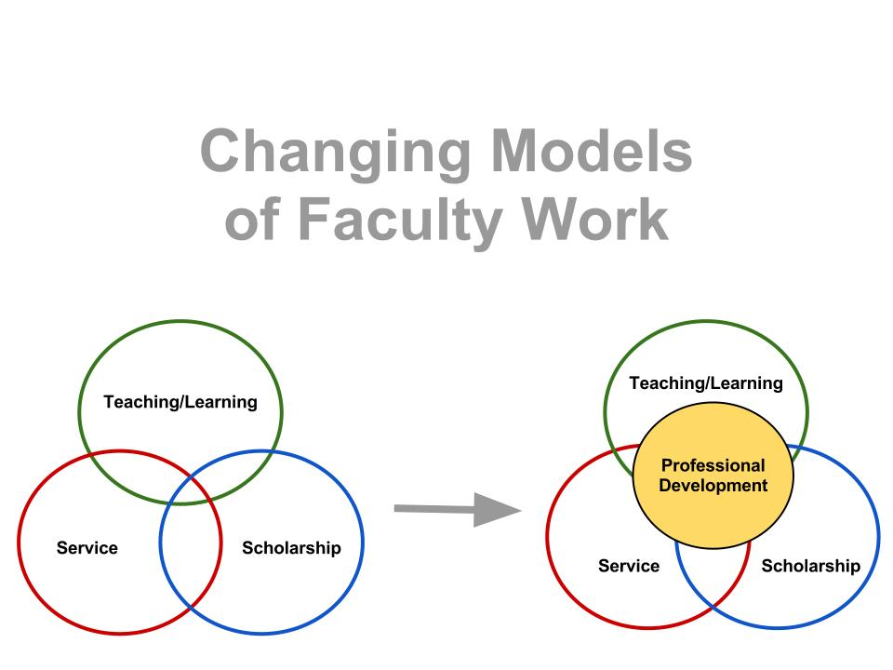
A Solution: Change the fundamental model of faculty work

Slide 8
The Holistic Department Concept

Slide 9
Some Modern Department Problems
Recruiting the talent needed beyond just curriculum demands ( like areas of specialty) to achieve these goals, for instance skills in supporting UG research, service learning, instructional technology, assessment, general education, etc.
The commitment and balance between teaching, research, service and professional development varies across faculty and during faculty lives. How do we utilize faculty so that they can best serve the department, college and their students best.

Slide 10
The Vision
Seeing the department as an organic whole, not just a collection of talented specialists.
Faculty workload is organized at the department level and Chairs play a major role in effectively managing faculty resources to meet department and institutional goals as well as supporting faculty with professional development through the lifecycle.
Faculty are utilized so as to enhance opportunities for colleagues in their department- relieving them of certain tasks for example to complete a grant, work on accreditation or finish a book.

Slide 11
Vision Goal
Faculty are supported and rewarded for filling other needs of the institution and the department, besides the expectations for teaching and scholarship, such as service learning, professional development undergraduate research, graduate school advising, assessment, diversity, college and departmental governance, general education and the innovative use of instructional technology.

Slide 12
The Outcome of the Model
Responds creatively and humanely to the changing characteristics of the professoriate.
Contributes to more individualized and flexible approaches to hiring, development, reward, and promotion.
Provides a framework for departments to consider a wide range of contributions faculty as a whole must make to achieve successful student learning outcomes, beyond the usual concern about research ( as measure of faculty competence) and areas of expertise ( to measure curricular integrity).
Allows for departments to be held accountable and evaluated in terms of how they achieve the overall goals set in the strategic plans for the department and the institution.

Slide 13
Checklist for implementing holistic department models
Initiate campus-wide conversations about the limitations of the current model of academic work and the advantages of the holistic model.
Maintain conversations across campuses and within programs until program buy-in is achieved.
Provide training for program chairs.
Ensure that each department’s model is developed through a collaborative effort that includes all departmental stakeholders.
Develop strategies for (a) building trust in the models as well as their implementation and (b) establishing accepted processes for periodic review and revision of departmental and faculty models.

Slide 14
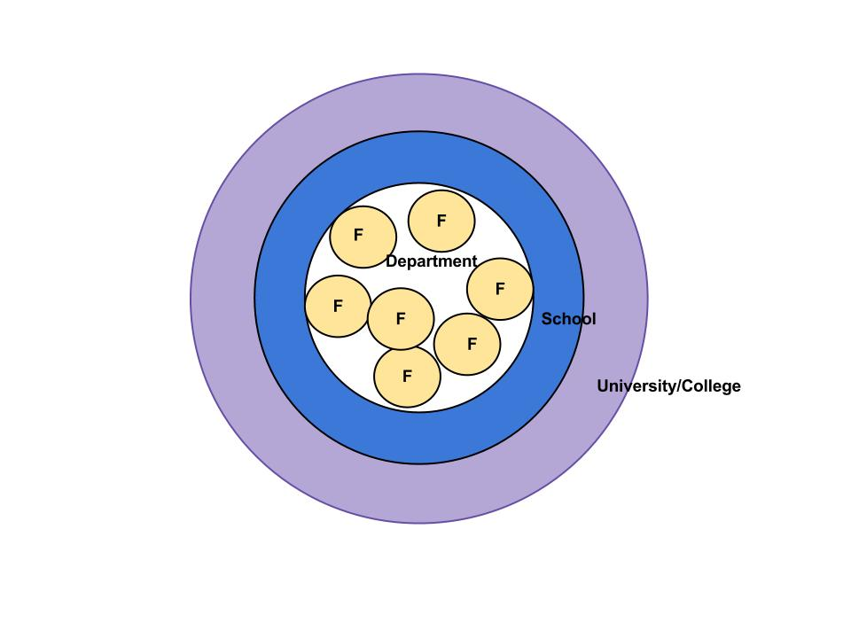
The Holistic Department

Slide 15
Faculty Development and Student Learning
21st century students need 21st century faculty
Changing roles of faculty are related to enhancing student learning
Faculty development is aligned with increased implementation of high-impact educational practices

Slide 16
Implications of Holistic Departments Approach for Student Learning
Departments can optimize faculty implementation of strategies that will achieve learning goals
Supports a “culture of evidence-based teaching and learning” within and across departments
Supports development of holistic institutions focused on achieving overall strategic goals

Slide 17
Implementing High-Impact Educational Practices (Kuh, 2008)
AAC&U’s LEAP Report (2007): Essential Learning Outcomes
High impact educational practices require high levels of faculty-student engagement
Significance of faculty leadership, engagement, and expertise to effectively implement a cohesive curriculum that encompasses high-impact practices

Slide 18
Integrating Liberal and Professional Studies
Supported by holistic departments that emphasize individualized faculty development
Intentionally includes high-impact educational practices
Associated with relevant learning goals that connect theory and practice
Promotes holistic and engaged educational outcomes

